Slide 1


Developing a Machine Learning webapp for Qualitative Data Analysis
Zsolt Takacs – 2472886T
Notes:
Hello, my name is Zsolt, and welcome to the presentation section of my level four individual porject: Developing a machine learning webapp for qualitative data analysis.

Slide 2

Overview
Overview of presentation
Background
Requirements
Design
Technologies
Demonstration of finished system
Testing
Evaluation
Future Work
Notes:
Here is a quick overview of this presentation. First we will look at the theoretical background this project is built upon then we will analyse the requirements and designs extracted from them. Then, I will introduce the chosen technologies and demonstrate the finished system. Finally, I will cover the testing and evaluation of the finished project and introduce some ideas for future work.

Slide 3
Background
How do Machine Learning and Qualitative Data Analysis meet?
Qualitative techniques are often described as subjective, unreliable and extremely time consuming
Machine Learning techniques are becoming accessible rapidly
Using machine learning to support qualitative data analysis can help overcome the mentioned issues
Less subjective coding
More reliable and reproducible results
Much faster initial coding process
This has been proposed by multiple researchers previously and have been used in research already
Most of the prominent applications to support qualitative data analysis offer similar solutions too
Notes:
So, in order to cover our background, first, we need to answer the big question. How do machine learning and qualitative data analysis meet? Qualitative research focuses on the experience of the individual or group and gives detailed descriptions of various phenomena. However, because of this, many people label it subjective and unreliable. This unreliability also comes from analysing a large data set being extremely time-consuming. Multiple researchers often code different subsets of the data rather than one person manually coding everything. However, including more researchers in this early data analysis stage can result in discrepancies, which is why some people still think that the yielded results are slightly unreliable. Hence, many of these qualitative research papers often opt for a smaller sample size, which affects the generalizability and reproducibility of these results.On the other hand, machine learning is becoming very accessible these days, and it can help qualitative data analysis techniques overcome these shortcomings. A correctly utilised machine learning model can create less subjective coding and produce more reliable and reproducible results. This is based on the assumption that machine learning models work on strict statistical rules rather than personal context. Hence, they are considered to be more objective. Finally, using these models can also speed up the analysis, as the model can process and create initial codes much faster than a manual coder could. This mixture of the two fields has been previously explored by multiple researchers. There have been suggestions on how to incorporate the two fields together on a theoretical basis. And quite a few papers are already utilising machine learning techniques to supplement qualitative data analysis. For qualitative researchers, there have been multiple applications out there that aim to ease their workload by offering organisational help. Some of the prominent products like NVivo ATLAS.ti or LIWC recently ventured into using different machine-learning techniques to help enhance their power and help their users. Based on the existing literature and the existing applications, topic modelling and sentiment analysis are the two most prominent machine learning techniques.

Slide 4
Requirements
Functional requirements prioritised using the MoSCoW technique
Container requirements:
Users must be able to upload a text for processing
Users should receive valuable information about how the product processes their texts
The entire system could compile a zip file of all the result files to avoid cluttering and
ML script requirements:
The Machine learning script must be able to work with different file extensions
The Machine learning script should be able to automatically calculate the optimal parameters for the machine learning models of their results
The Machine learning script could provide visualization of the most important words and their contribution to the topics
Non-functional requirements
Notes:
Based on the existing literature and products, a list of requirements was compiled. These were done using the Moscow technique, categorising every requirement into must-have, should-have, could-have and would-be-nice-to-have categories. Further to that, these functional requirements were divided into two larger sets regarding the container and the machine learning scripts themselves. So, the container requirements described how the proposed system should look like and what logic it should follow. While the machine learning requirements described the input and the output and some of the low levels of the logic of how the models are created and trained. Further to that, we also had a few non-functional requirements. One of the highest priority non-functional requirements was availability so that the system is widely available to many users. Security and privacy were also among the top ones to adhere to privacy regulations like GDPR. Some examples are currently on the slides, but a full set is available within the dissertation.

Slide 5
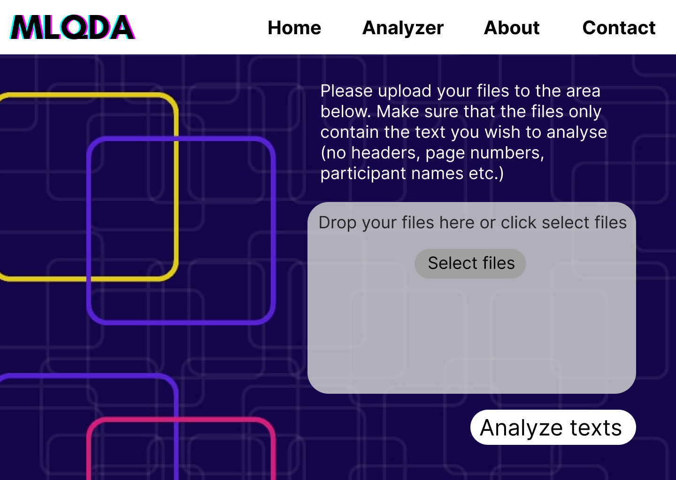
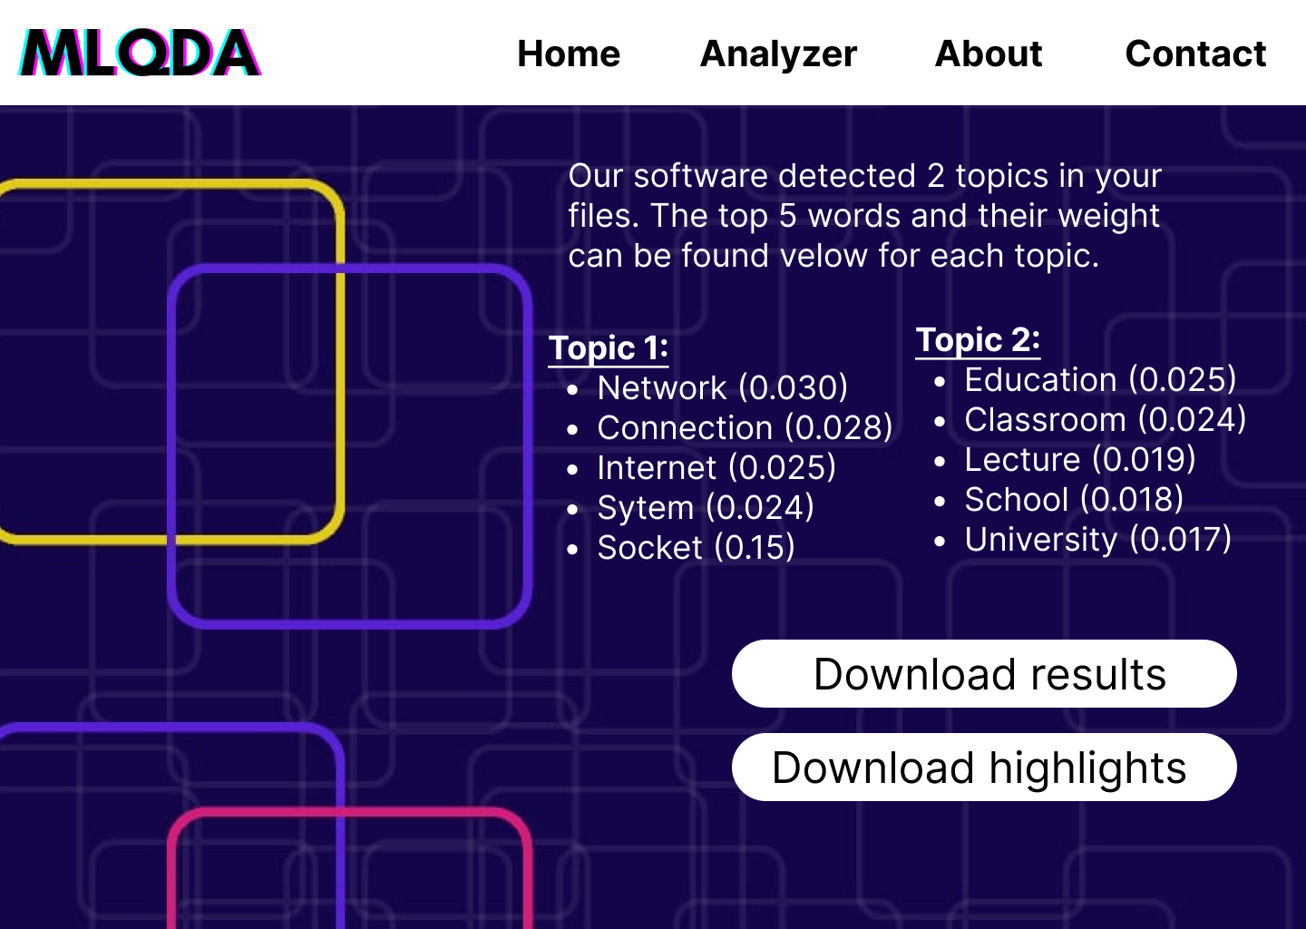
Design
Based on requirements Figma wireframes were developed and converted into a realistic prototype
Analyser start page
Analyser results page
Notes:
The first step after gathering and organising the requirements was to create the design elements before starting the implementation. One of the major design elements were the wireframes and the prototype. On the slides, wireframes represent the most essential part of the system: uploading the files and then displaying the results based on those files. The user can select the analyser, and we will receive general guidance about the process and how to format files. Then with one button click and sometime later, they will be redirected to a results page which is on the right-hand-side, where they will be welcomed again by some guidance on how to interpret the results and the high-level description of their results and, finally, gonna be the option to actually download that results. In this process, six wireframes were created to represent the system and converted into a realistic prototype using Figma. Both are fully available within the dissertation and in the compressed folder.

Slide 6
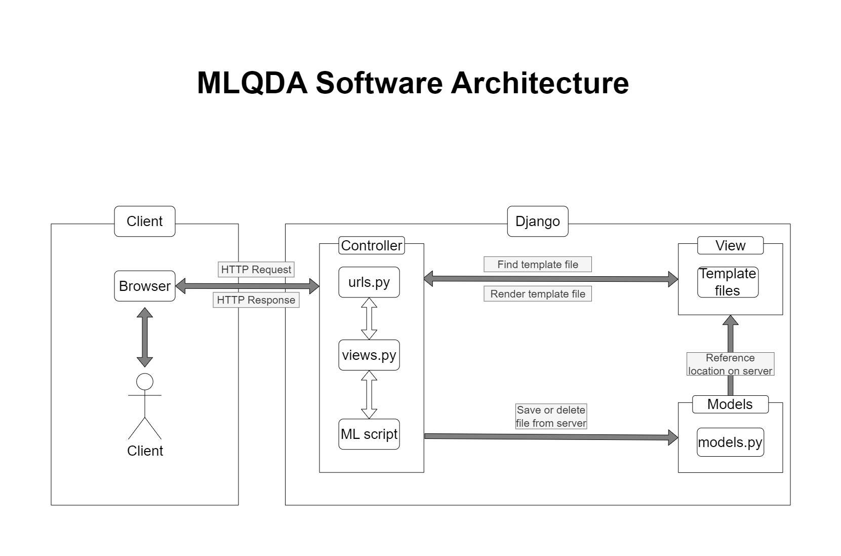
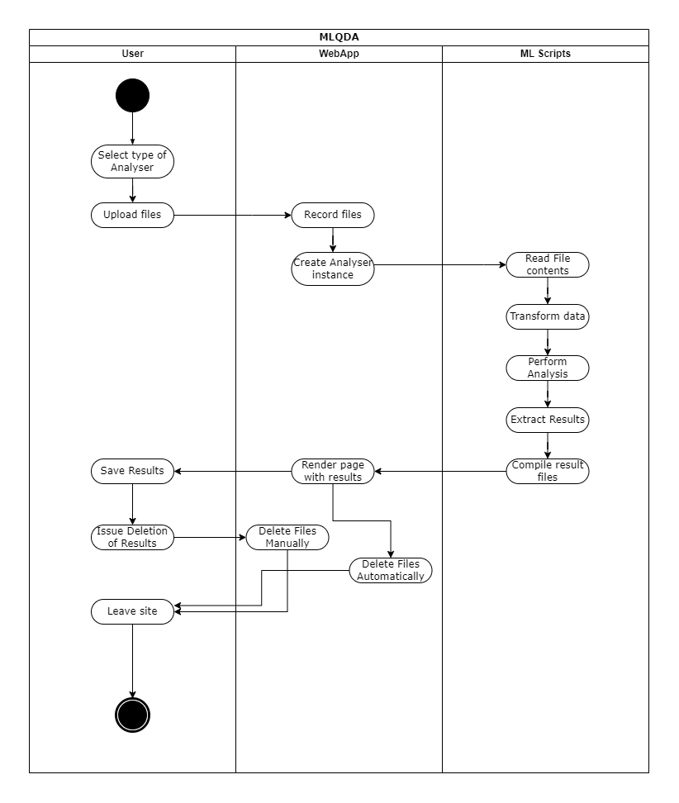
Design
Based on requirements a system architecture diagram and a user activity diagram was sketched out to represent the inner logic of the proposed system.
Proposed Software Architecture
Activity Diagram
Notes:
Similarly to the wireframes, based on the requirements, a software architecture diagram and a user activity diagram were created to represent the logic system and how a user would actually use the system. So the software architecture describes the conventional model view controller setup, supplemented by a unique addition: the machine learning script that is the core part of this project. The user activity diagram showcases how a user flow should look like.
In short, people would access the site and gather information on how the site works and how to format their files which they would need to follow. Then they would select which type of analysis they would want to do and upload their files. Once the click OK everything else is handled by the system. It reads the content of those files, converts them, analyses them and runs the machine learning models on them. Finally, after the models are obtained, the results are extracted. Then, the system compiles these into meaningful formats, which are then returned to the user as a new page on the website. Here they can also download their results. Finally, they have the option to either delete their files manually, or if they fail to do that, then the system itself will delete them after the passing of an hour. But in both cases, the user should end up with a copy of their analysed results.

Slide 7







Technologies
Notes:
This slide presents the main technologies used to develop the system. The primary programming language was Python which was supplemented by the Django framework to create a web app using an SQL lite database. The whole project was deployed on PythonAnywhere. The machine learning scripts are supported by various libraries. The most notable ones are NLTK or natural language processing toolkit, Gensim and Spacy. So, these last three libraries are in charge of processing the text and creating machine-learning models.

Slide 8
Demonstration of the finished system

Slide 9
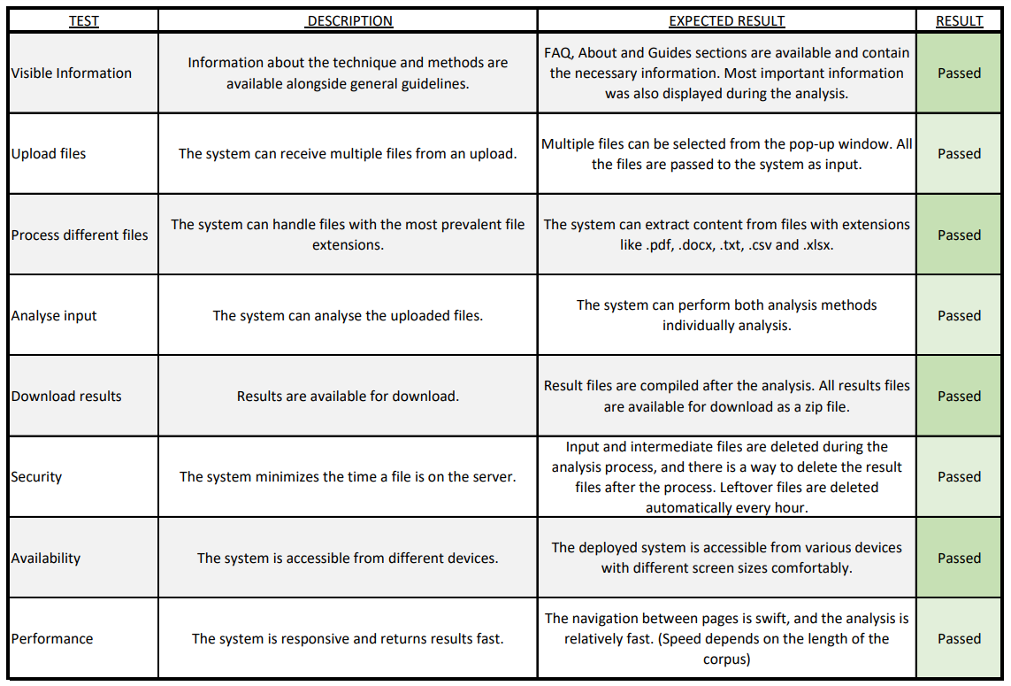
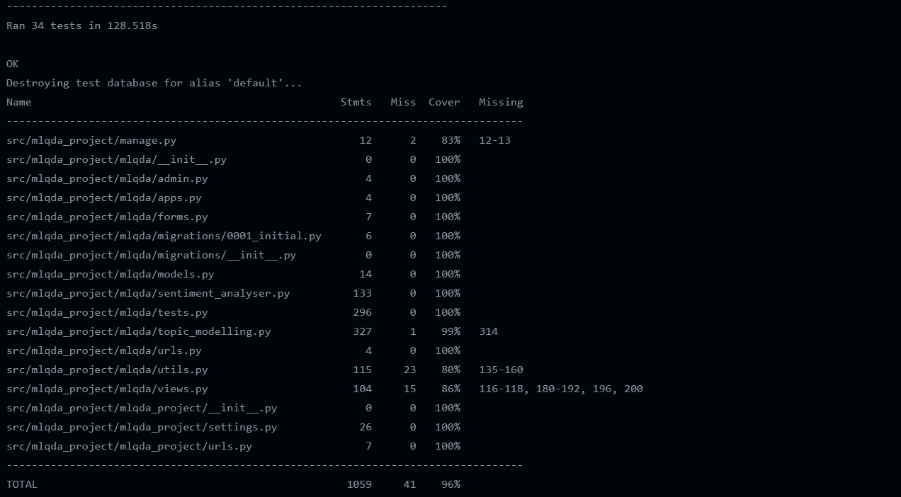
Testing
Two major type of testing – Manual Testing and Unit Testing:
Manual Testing table filled out after every deployment
Unit tests developed concurrently to code base and run as part of the CI pipeline
Manual Testing Table
Unit Test Coverage Report
Notes:
Testing was developed parallel to the implementation of the features, which meant that testing cases were also developed as soon as a feature was implemented. After the minimum viable product was achieved, manual testing also frequently occurred. So, both unit and manual tests were usually executed after every commit to ensure a workable code on the repository. However, unit tests were also included in the continuous integration pipeline to ensure that the code is capable of compilation both on the development and the main branch. The screenshots below show that all manual tests have passed at the end of development, and the unit tests covered an extremely high percentage of the code.

Slide 10
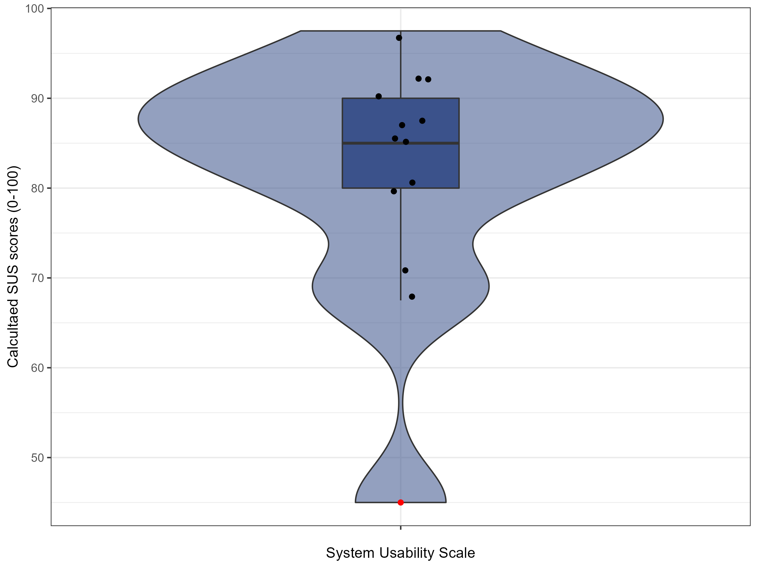
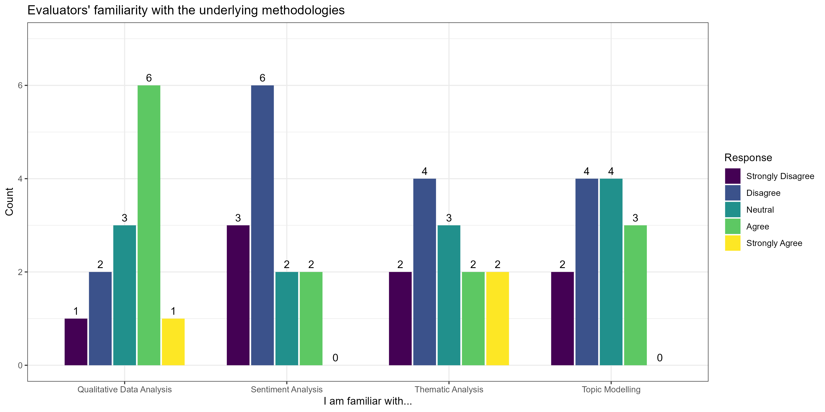
Evaluation
The evaluation of the system took place in two steps
Pilot user evaluation by an qualitative analysis expert to gather general feedback
Open user evaluation to quantify system usability and gather more feedback
Notes:
Apart from testing, evaluation was also crucial by the end of development. First, a pilot evaluation took place by a third-party lecturer who is an expert in qualitative data analysis. They provided an unstructured review of the system, highlighting a few missing features, but still supported the project. After their feedback, a few additional features were implemented. The large-scale user evaluation was deployed using an online survey circulated among people with qualitative research backgrounds and those with more of a computing science background. Throughout the evaluation, 13 people filled out the survey.The figure on the bottom left shows their experience with the used technologies. The industry standard system usability scale was utilised to measure the system's usability. The mean score for the system was above 82, which is above the suggested 70-point threshold to indicate a very usable system. However, two respondents scored the system under this threshold, but the overall average indicates that people enjoyed using the system. Apart from quantitative measures, participants also gave unstructured qualitative comments on the system and about possible features they would like to see. Many of them expressed the ease of use of the overall system. However, the most prominent issue they highlighted was the unclear guidance on the pages relating to the process itself. Most of the suggestions were kept on separate pages on the website.

Slide 11
Future Work
Include alternative machine learning techniques
Improve Topic Modelling visualisation by updating pyLDAvis
Scale up Topic Modelling to allow a more dynamic way of hyperparameter usage
Automate highlighting after manual changes in topic words
Include more instructions to support first-time users
Notes:
Based on the feedback and the few unfinished stretch goals, there are a few options for future work. First, the project's main aim was to include one type of machine learning. Even though by the end, two different techniques were implemented, these can still be supplemented with other types of machine learning. For example, if the user could provide a sufficient training set, the system could automate manual coding.But as seen on the slides, multiple ways exist to increase the efficiency and reliability of the existing topic modelling technique. Finally, as it was very much suggested by the evaluation participants, it would be beneficial to include more precise instructions and guidance throughout the analysis pages. Dealing with these, rather than keeping them separate, will help first-time users.

Slide 12
References
Blei, D. M., Ng, A. Y., & Jordan, M. I. (2003). Latent dirichlet allocation. Journal of machine Learning research, 3(Jan), 993-1022.
Braun, V., & Clarke, V. (2006). Using thematic analysis in psychology. Qualitative research in psychology, 3(2), 77-101.
Chen, N. C., Drouhard, M., Kocielnik, R., Suh, J., & Aragon, C. R. (2018). Using machine learning to support qualitative coding in social science: Shifting the focus to ambiguity. ACM Transactions on Interactive Intelligent Systems (TiiS), 8(2), 1-20
Crowston, K., Allen, E. E., & Heckman, R. (2012). Using natural language processing technology for qualitative data analysis. International Journal of Social Research Methodology, 15(6), 523-543.
Janasik, N., Honkela, T., & Bruun, H. (2009). Text mining in qualitative research: Application of an unsupervised learning method. Organizational Research Methods, 12(3), 436- 460.
Parks, L., & Peters, W. (2022). Natural Language Processing in Mixed-methods Text Analysis: A Workflow Approach. International Journal of Social Research Methodology, 1-13.

